Slide 1
Lecture 7: The Second and Third Laws of Thermodynamics
Outline
Definition of the Second Law
Determining ΔS
Definition of the Third Law

Slide 2
The Second Law
The Second Law: there is always an increase in the entropy of the universe.
From our definitions of system and surroundings:
ΔS_{universe} = ΔS_{system} + ΔS_{surroundings}

Slide 3
The Second Law (cont.)
Three possibilities:
If ΔS_{univ} > 0…..process is spontaneous
If ΔS_{univ} < 0…..process is spontaneous in opposite direction.
If ΔS_{univ} = 0….equilibrium
• We need to know ΔS for both
the system and surroundings to predict if a
reaction will be spontaneous!

Slide 4
The Second Law (cont.)
Consider a reaction driven by heat flow from the surroundings at constant P.
Exothermic Process: ΔS_{surr} = heat/T
Endothermic Process: ΔS_{surr} = -heat/T
Heat transferred = q_{P,surr} = - q_{P,system=} -ΔH_{sys}

Slide 5
Example
For the following reaction at 298 K:
Sb₄O₆(s) + 6C(s) 4Sb(s) + 6CO₂(g) ΔH = 778 kJ
What is ΔS_{surr}?
ΔS_{surr} = -ΔH/T = -778 kJ/298K = -2.6 kJ/K

Slide 6
The Third Law
Recall, in determining enthalpies we had standard state values to use. Does the same thing exist for entropy?
The third law: The entropy of a perfect crystal at
0K is zero.
The third law provides the reference state for use
in calculating absolute entropies.

Slide 7
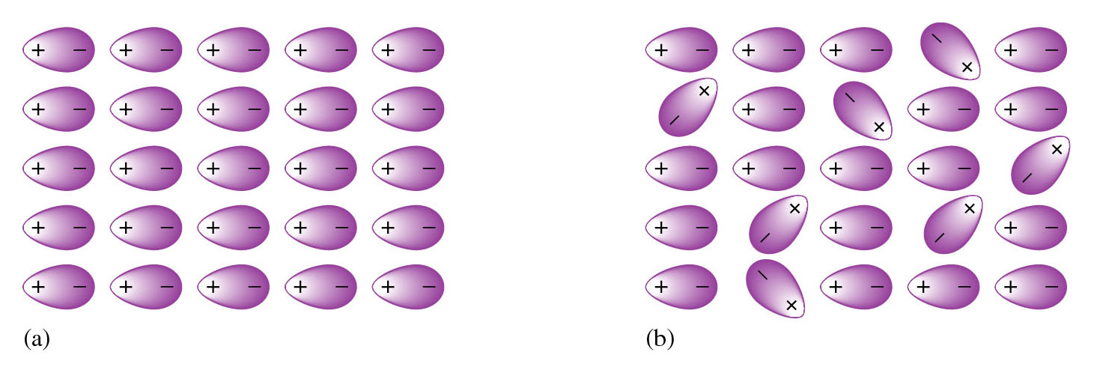
What is a Perfect Crystal?
Perfect crystal at 0 K
Crystal deforms at T > 0 K

Slide 8
Standard Entropies
With reference to this state, standard entropies have been tabulated (Appendix 4).
Recall, entropy is a state function; therefore, the entropy change for a chemical reaction can be calculated as follows:

Slide 9
Example
Balance the following reaction and determine ΔS°_{rxn}.
Fe(s) + H₂O(g) Fe₂O₃(s) + H₂(g)
2Fe(s) + 3H₂O(g) Fe₂O₃(s) + 3H₂(g)
ΔS°_{rxn} = (S°(Fe₂O₃(s)) + 3S°H₂(g))
-(2S°Fe(s) + 3S°H₂O(g))
ΔS°_{rxn} = -141.5 J/K

Slide 10
Big Example
Is the following reaction spontaneous at 298 K?
(Is ΔS°_{univ} > 0?)
2Fe(s) + 3H₂O(g) Fe₂O₃(s) + 3H₂(g)
ΔS°_{rxn} = ΔS°_{system} = -141.5 J/K
ΔS°_{surr} = -ΔH°_{sys}/T = -ΔH°_{rxn}/T
ΔH°_{rxn}= ΔH°_{f}(Fe₂O₃(s)) + 3ΔH°_{f}(H₂(g))
- 2ΔH°_{f}(Fe (s)) - 3 ΔH°_{f}(H₂O(g))

Slide 11
Big Example (cont.)
ΔH°_{rxn}= -100 kJ
ΔS°_{surr} = -ΔH°_{sys}/T = 348 J/K
ΔS°_{univ} = ΔS°_{sys} + ΔS°_{surr}
= -141.5 J/K + 348 J/K
= 207.5 J/K
ΔS°_{univ} > 0 ; therefore, reaction is spontaneous

Slide 12
Entropy and Phase Changes
Phase Change: Reaction in which a substance goes from one phase of state to another.
Example:
H₂O(l) H₂O(g) @ 373 K
Phase changes are equilibrium processes such that:
ΔS_{univ} = 0

Slide 13
S and Phase Changes (cont.)
H₂O(l) H₂O(g) @ 373 K
• Now, ΔS°_{rxn} = S°(H₂O(g)) - S°(H₂O(l))
= 195.9 J/K - 86.6 J/K
= 109.1 J/K
• And, ΔS°_{surr} = -ΔH_{sys}/T
= -40.7 kJ/373 K
= -109.1 J/K
• Therefore, ΔS_{univ} = ΔS_{sys} + ΔS_{surr} = 0

Slide 14
Example
Determine the temperature at which liquid bromine boils:
Br₂(l) Br₂(g)
• Now, ΔS°_{rxn} = S°(Br₂ (g)) - S°(Br₂(l))
= 245.38 J/K - 152.23 J/K
= 93.2 J/K

Slide 15
Example (cont.)
• Now, ΔS°_{surr} = - ΔS°_{sys} = -93.2 J/K = -ΔΗ_{sys}/T
• Therefore, calculate ΔH_{sys} and solve for T!
0
• Now, ΔH°_{rxn} = ΔH°_{f}(Br₂(g)) - ΔH°_{f}(Br₂(l))
= 30.91 kJ - 0
= 30.91 kJ
(standard state)
• Such that, -93.2 J/K = -30.91 kJ/T
T_{boiling} = 331.6 K

